Slide 1
INFO 250 Information Visualization
Week 2B: Ontologies of visualization
Types of charts
A framework for analyzing and evaluating visualization

Slide 2
Datasets for consideration
Information is beautiful: https://informationisbeautiful.net/data/
Data.gov: https://www.data.gov/ (and open government data portals in other countries!)
Fivethirtyeight Data: https://data.fivethirtyeight.com/
Our world in data: https://ourworldindata.org/

Slide 3
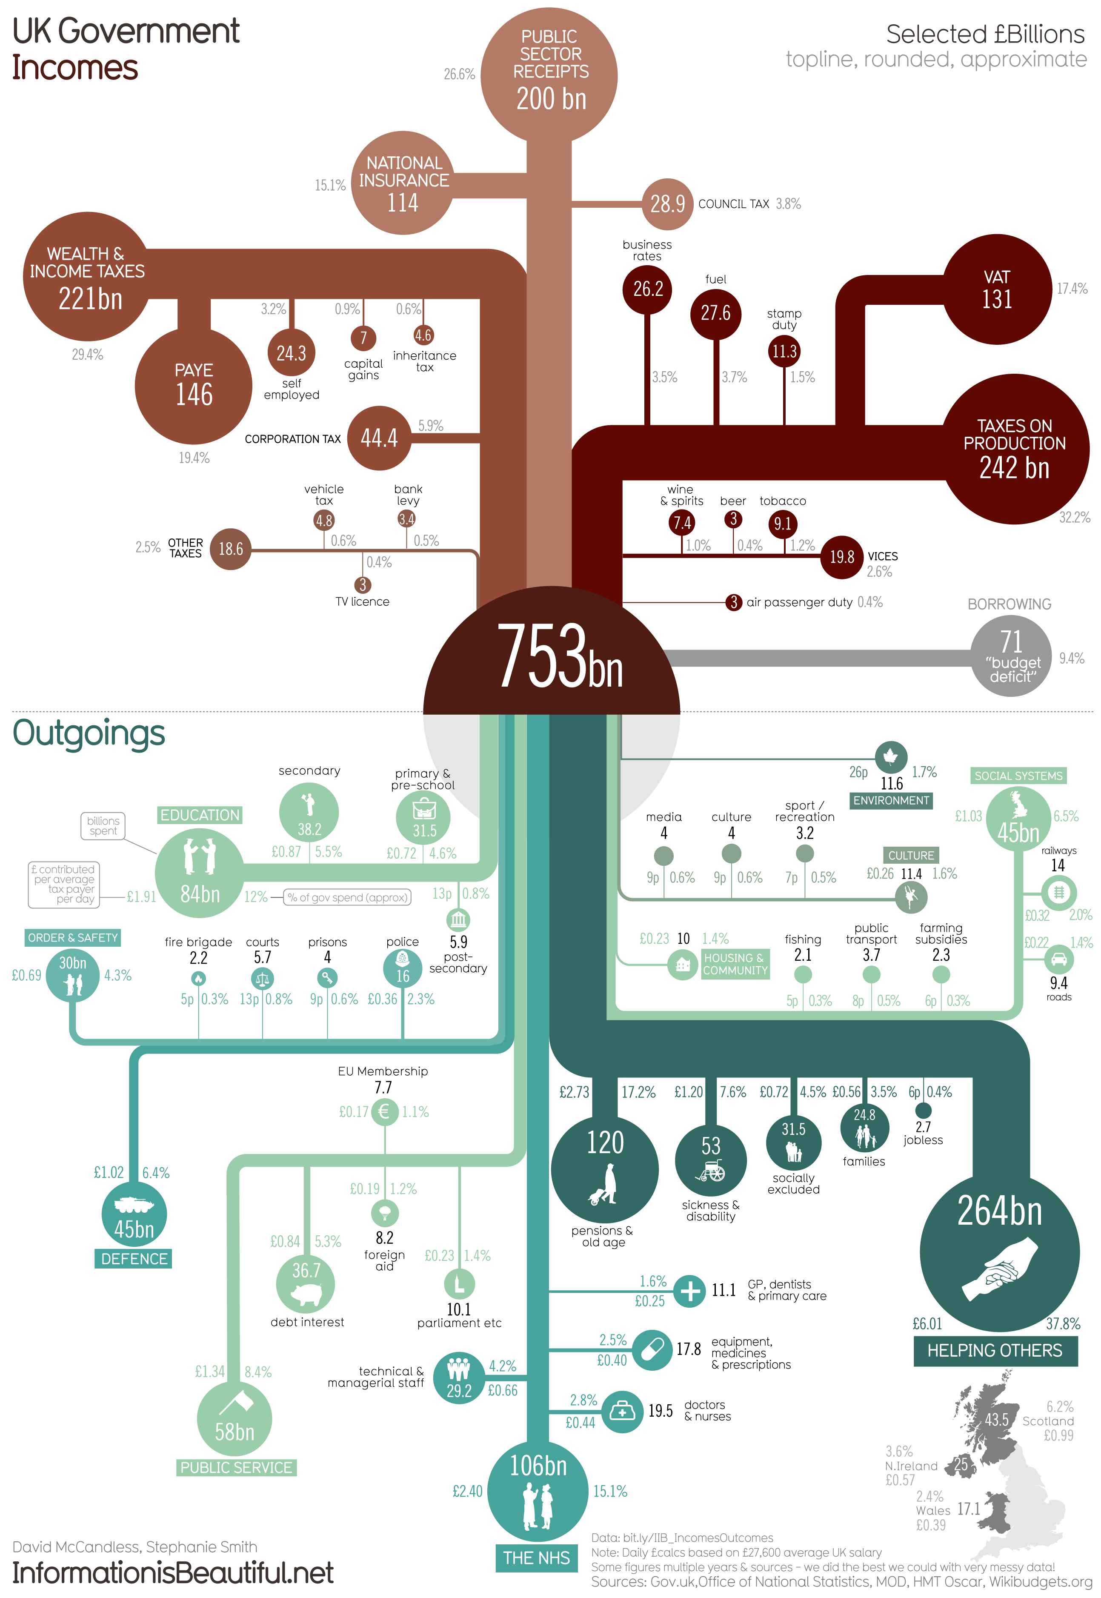
https://informationisbeautiful.net/visualizations/uk-government-spending-incomes-outcomes/
by Stephanie Smith, David McCandless | £billion | % of spend | £ contribution per taxpayer per day
informationisbeautiful.net | 698.27 |  | £27,600
Public services | 58.71 | 8.4% | 1.34 | public services
-goverment itself | 10.10 | 1.4% | 0.23 | public services
-foreign aid | 8.17 | 1.2% | 0.19 | public services
-debt interest | 36.72 | 5.3% | 0.84 | public services
Defence | 44.80 | 6.4% | 1.02 | defence
-military defence | 34.00 | 4.9% | 0.77 | defence
--nuclear contingency | 2.40 | 0.3% | 0.05 | defence
--submarines | 3.80 | 0.5% | 0.09 | defence
--ships | 2.00 | 0.3% | 0.05 | defence
--land vehicles | 1.20 | 0.2% | 0.03 | defence
--aircraft | 2.25 | 0.3% | 0.05 | defence
Public order & safety | 30.18 | 4.3% | 0.69 | protection
-police | 16.00 | 2.3% | 0.36 | protection
-fire brigade | 2.18 | 0.3% | 0.05 | protection

Slide 4
Types of Charts
Pie chart
Bar chart
Line chart
Scatterplot
Small multiples

Slide 5
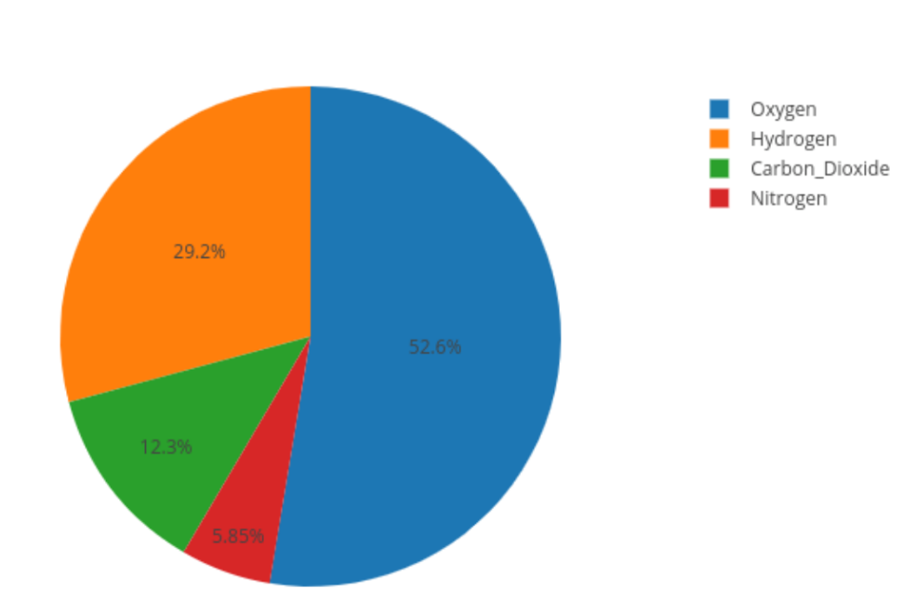
A framework for analyzing and evaluating information visualization
What seems to stand out?
What is the whole? What are the parts?
What are the underlying data types represented?
What tasks are supported? What can we do with it?
What are the most obvious alternative design options?
Is there anything ambiguous?
Is there anything inconsistent?
Is there an overall message?
Does it change what you know?

Slide 6
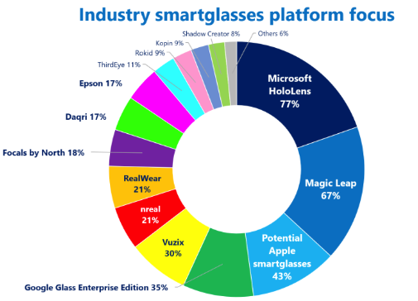
Donut vs Pie
https://viz.wtf/

Slide 7
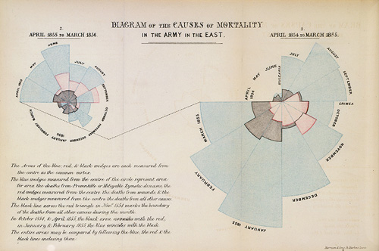
Nightingale’s Polar Area Diagram, or "coxcombs" as she called them.
The mortality figures during the Crimean War (1854 - 56).

Slide 8
The mortality during the Crimean War (1854 - 56)
The polar area diagram , or coxcomb, was invented by Florence Nightingale to dramatize the extent of needless deaths in British military hospitals during the Cirmean War (1954-56). The area of each colored wedge, measured from the center, is proportional to the statistic being represented.
Blue wedges => deaths from "preventable or mitigable zymotic" diseases (contagious diseases such as cholera and typhus)
Pink wedges => deaths from wounds
Gray wedges => deaths from all other causes
Originally from Nightingale's book Notes on Matters Affecting the Health, Efficiency and Hosptal Administrtion of the British Army, published in 1858.

Slide 9
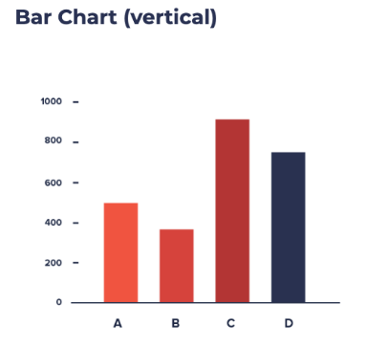
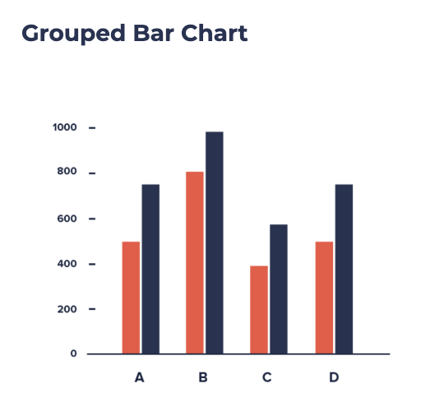
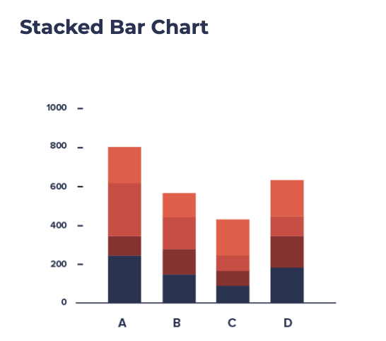
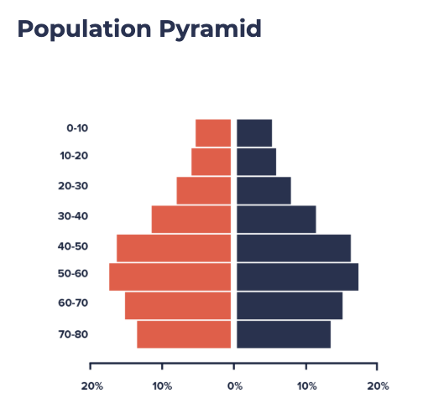
Bar charts
What seems to stand out?
What is the whole? What are the parts?
What are the underlying data types represented?
What tasks are supported? What can we do with it?
What are the most obvious alternative design options?
Is there anything ambiguous?
Is there anything inconsistent?
Is there an overall message?
Does it change what you know?
Notes:
Stacked: summable but not comparable
Grouped: Comparable between groups and between observations
Opposite: can do both compare and sum, but can only support two groups well

Slide 10
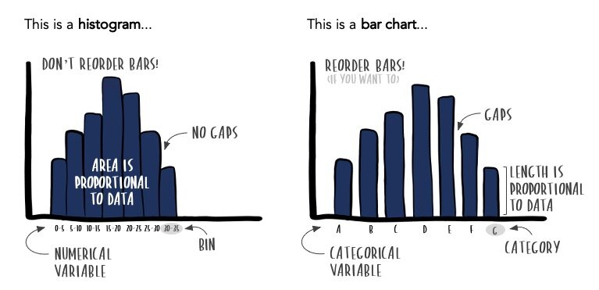
Bar chart vs histogram
https://www.storytellingwithdata.com/blog/2021/1/28/histograms-and-bar-charts

Slide 11
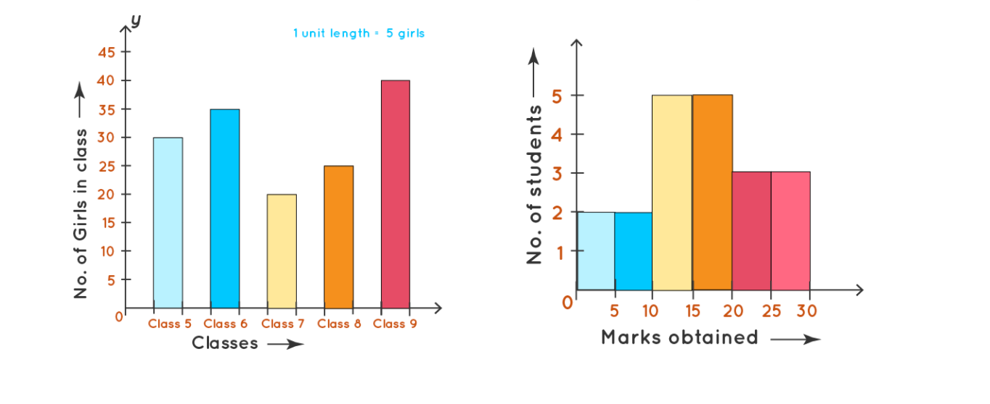
Bar chart vs histogram

Slide 12
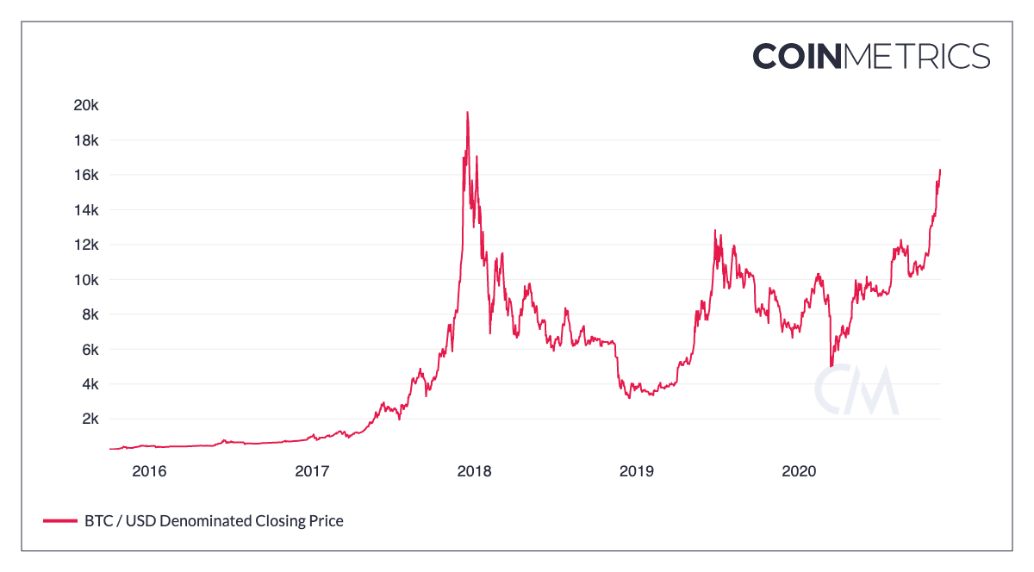
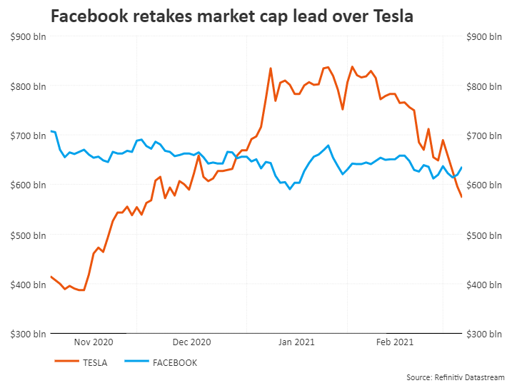
Line chart

Slide 13
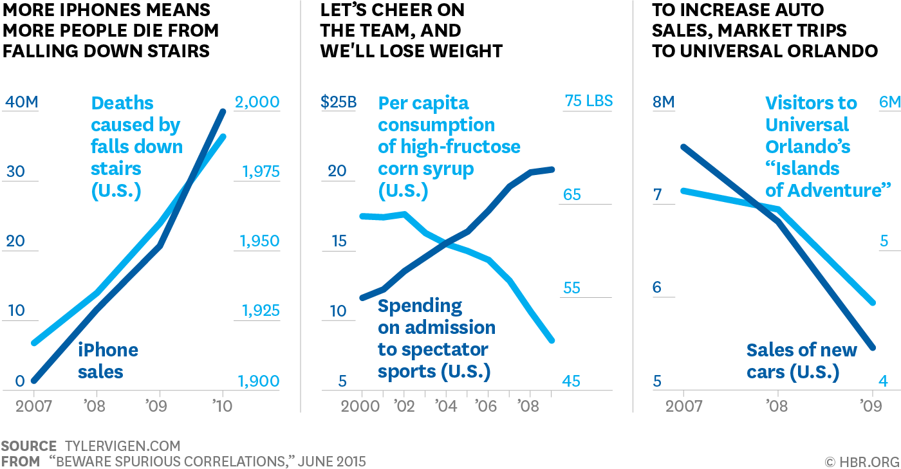
Line chart: Spurious correlation

Slide 14
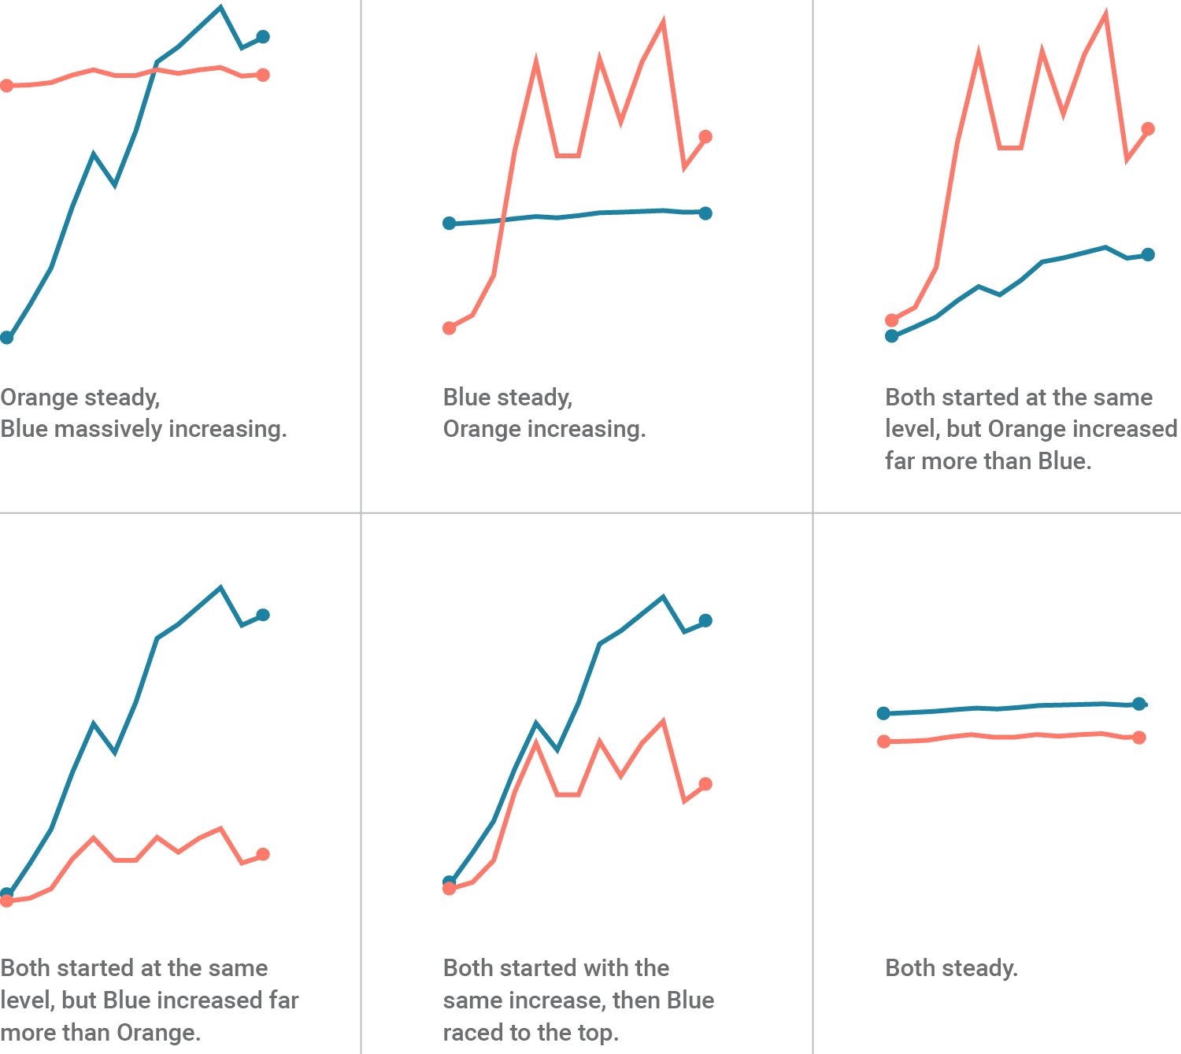
Spurious correlation: How to avoid?
DO NOT:
  Plot unrelated things together;
  Using two y-axes in any graph;
  Cut numerical axes in any graph;
  Use Pareto chart (https://datavizproject.com/data-type/pareto-chart/)
https://blog.datawrapper.de/dualaxis/

Slide 15
Spurious correlation and Big data
Spurious correlation (some events are correlated but not causally related) is a major potential problem for big data analysis, because when a dataset is large enough, everything could be correlated with everything. (https://link.springer.com/article/10.1007/s10699-016-9489-4)

Slide 16
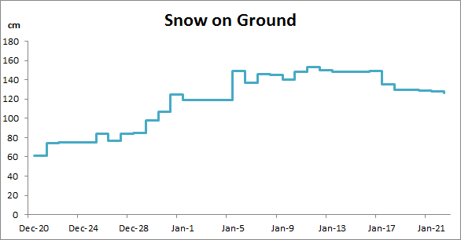
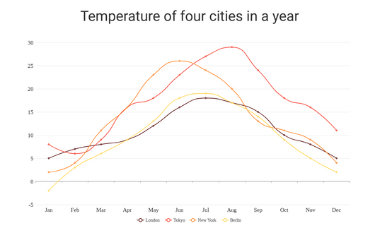
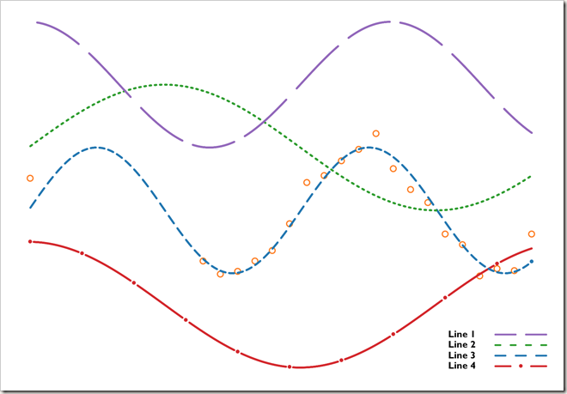
Stepped, curved, and dotted line charts
(A)
(B)
Appears more stable than it is.
Shows general patterns but less precisely on specific points of change.

Slide 17
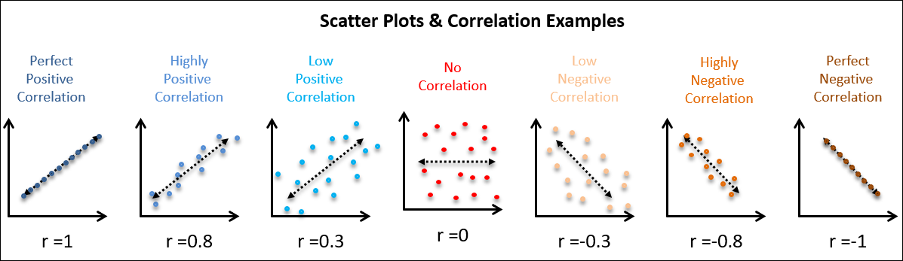
Scatterplot

Slide 18
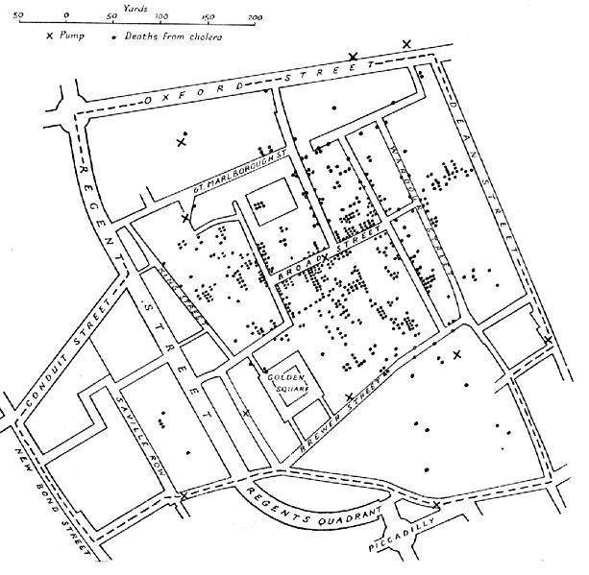
John Snow’s Cholera Map
https://blogs.cdc.gov/publichealthmatters/2017/03/a-legacy-of-disease-detectives/

Slide 19
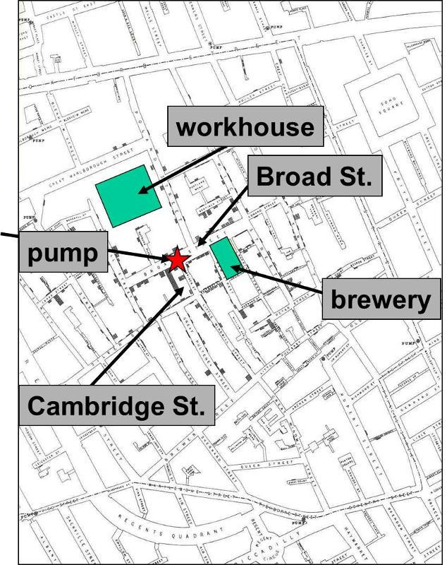
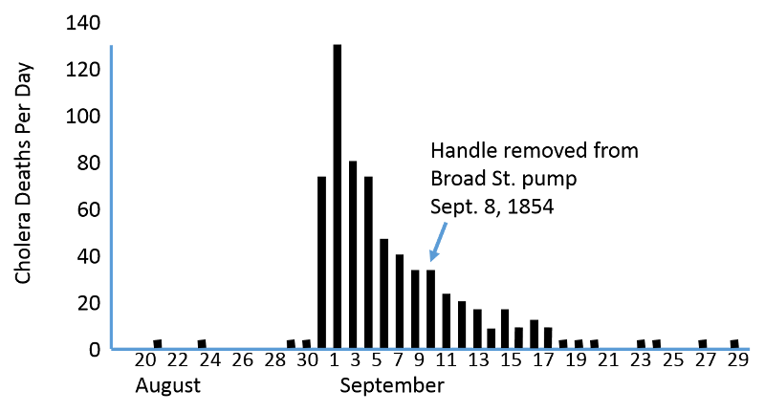
https://sphweb.bumc.bu.edu/otlt/mph-modules/ep/ep713_history/ep713_history6.html

Slide 20
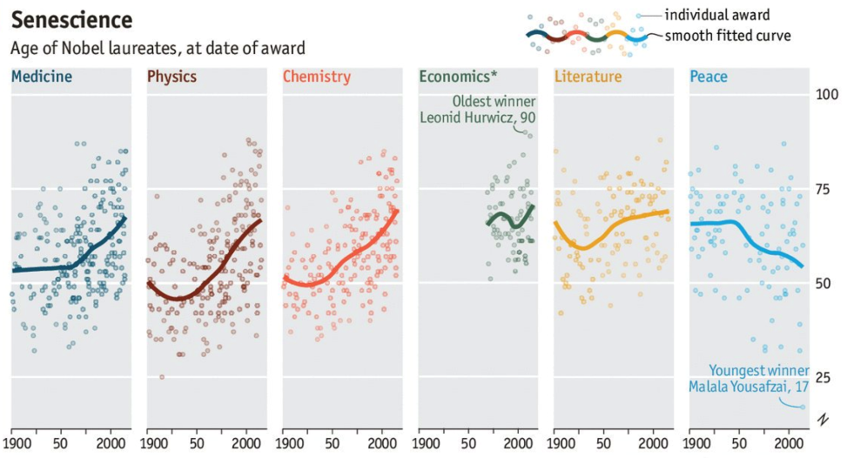
Small multiples
A small multiple (also called trellis chart, lattice chart, grid chart, or panel chart) is a series of similar charts using the same scale and axes, allowing them to be easily compared.”
https://en.wikipedia.org/wiki/Small_multiple
https://twitter.com/ECONdailycharts/status/782997404547223552

Slide 21
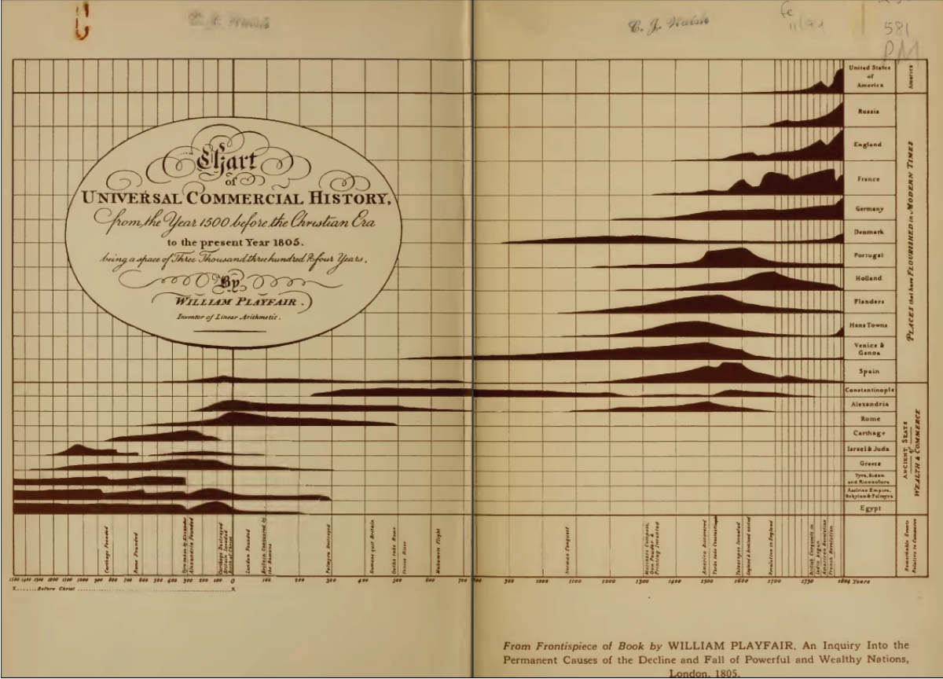

Slide 22
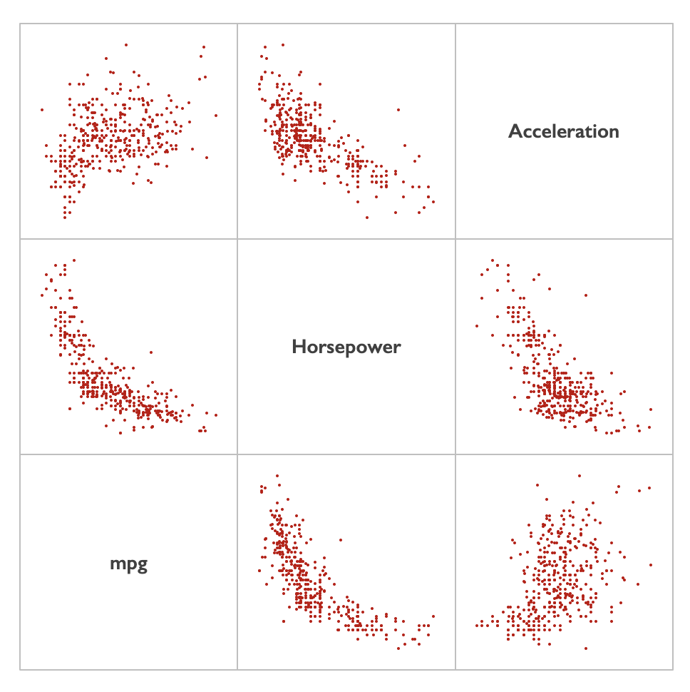
Scatterplot Matrix

Slide 23
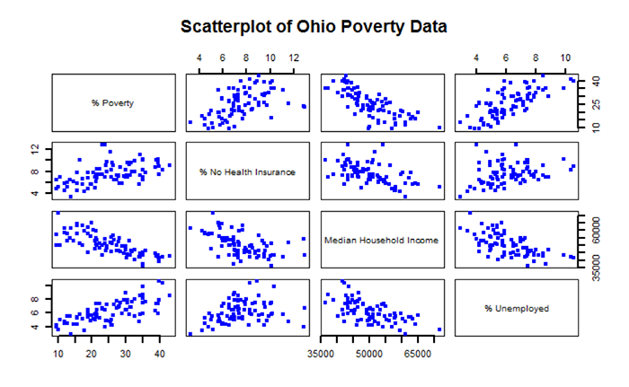

Slide 24
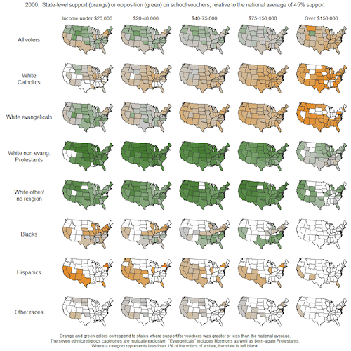

Slide 25
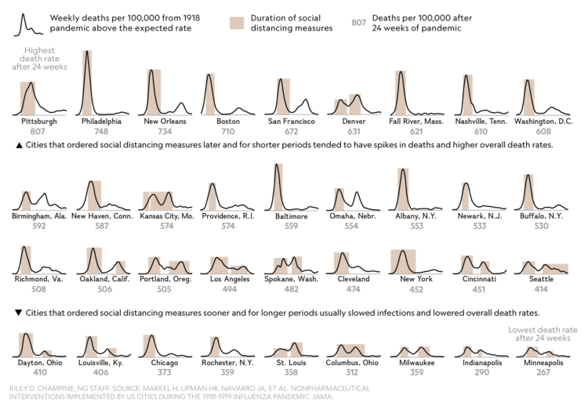
Curves for the 1918 flu pandemic

Slide 26
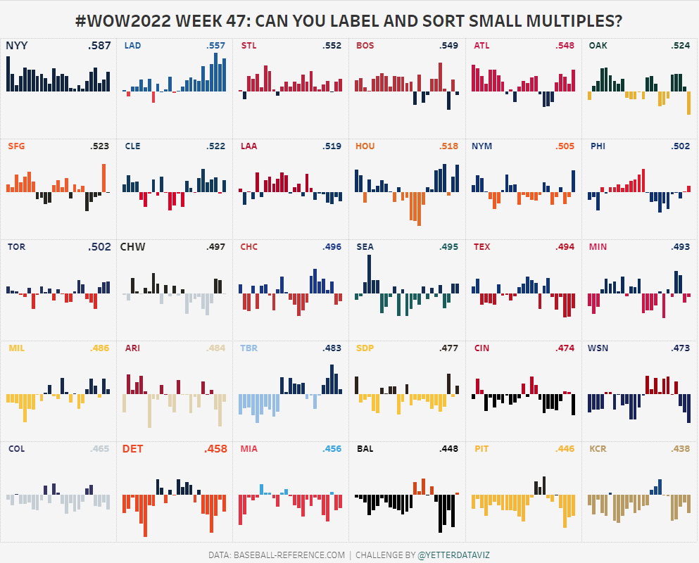
https://workout-wednesday.com/2022w47tab/

